Slide 1

2021

Slide 2
Data Science and AI
Module 7
Decision Trees

Slide 3
Agenda: Module 7
Overview
Decision Trees
Advantages and Disadvantages
Decision trees in Scikit Learn
Setting hyperparameters
Random Forests

Slide 4
Decision Trees
A type of supervised Machine Learning algorithm.
It is one of the most widely used and practical methods for classification. It is the simplest and yet the most powerful algorithm!
A decision tree is a tree in which each branch node represents a choice between a number of alternatives, and each leaf node represents an outcome.
The type of the target variable defines the type of Decision Tree
  Categorical variable Decision Tree: Has categorical target variable
  Continuous variable Decision Tree: Has continuous target variable

Slide 5
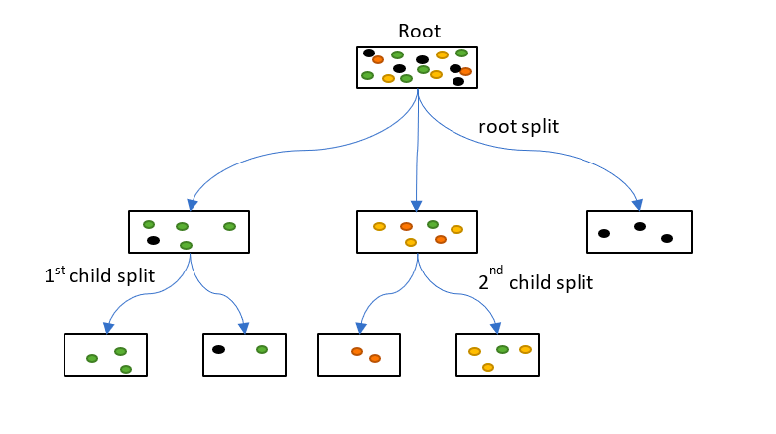
Constructing Decision Trees
The approach is to: Iteratively separate data into homogeneous groups
  Split data by category or range, one feature at a time
  Into groups as pure as possible
  repeating the process until a certain stop condition is reached

Slide 6
Iteratively separate data into homogeneous groups
Split 1
Predict Red
Predict Green
Split 2
Split 3
Predict Red
Predict Green

Slide 7
Mapping the Decision Tree
No
WEIGHT
> 60
Yes
Red
Green
JUICE
> 20
RED
No
Yes
WEIGHT
> 85
No
Yes
GREEN
Red
Green
RED
GREEN

Slide 8
Constructing Decision Trees - Example 2
Given 30 students with variables Gender (Boy, Girl), Height (5-6 ft) and Class(A, B). 15 out of these 30 play cricket in leisure time. Predict who plays cricket during leisure period?
Need to segregate students who play cricket in their leisure time based on highly significant input variable among all three (gender, height, weight).
Decision Tree segregates students based on all values of the three variables and identifies the variable, which creates the best homogeneous sets of students (heterogeneous to each other).
Decision tree identifies the most significant variable and its value which gives the best homogeneous sets of population.

Slide 9
Constructing Decision Trees - Example 2
The variable Gender can identify the most homogeneous sets compared to the other two variables
Split by Gender
Split by Height
Split by Class
Students: 30
Play: 15 (50%)
Female
Students: 10
Play: 2 (20%)
Male
Students: 20
Play: 13 (65%)
< 5.5 ft
Students: 12
Play: 5 (42%)
>= 5.5 ft
Students: 18
Play: 10 (56%)
Class A
Students: 14
Play: 6 (43%)
Class B
Students: 16
Play: 9 (56%)

Slide 10
Terminology
Root Node: Represents all the data and gets divided into two or more homogeneous sets
Splitting: Process of dividing a node into two or more sub-nodes
Decision Node: When a sub-node splits into further sub-nodes
Leaf or Terminal Node: Nodes that do not split

Slide 11
Terminology
Pruning: Remove of sub-nodes of a decision node
Branch or Sub-Tree: A subsection of the entire tree
Parent Node: A node divided into sub-nodes is the parent of those sub-nodes
Child Node: Sub-nodes resulting of a node division are children of such node

Slide 12
Constructing Decision Trees - Greedy Decision Tree Learning
Start with an empty tree
Select a feature to split the data
  (Look for the feature that gives the smallest classification error)
For each split of the tree
  If reached stop condition (purity, # elements, depth)
  then make predictions
  Otherwise, go to 2. and continue recursively on this split

Slide 13
Advantages of Decision Trees
Less data cleaning required: it can deal with categorical features directly without encoding and is not confused too much by outliers and missing values to a fair degree.
Non-Parametric Method: Have no assumptions on space distribution and classifier structure.
Easy to Understand: It does not require any statistical knowledge to read and interpret.
Its graphical representation is very intuitive, and users can easily relate their hypothesis.
Useful in Data Exploration: Good way to identify the most significant variables and their relations;
Can help to identify the most significant variable when working with hundreds of them.

Slide 14
Disadvantages of Decision Trees
Overfitting: One of the most practical difficulty for decision tree models.Decision-tree can create over-complex trees that do not generalise the data well.
Decision trees can be unstable because small variations in the data might result in a completely different tree being generated.
There are concepts that are hard to learn because decision trees do not express them easily, such as XOR concept.
Decision tree learners create biased trees if some classes dominate. It is therefore recommended to balance the dataset prior to fitting with the decision tree.

Slide 15
Decision Tree Algorithms (most common)
CART (Classification And Regression Tree)
ID3 (Iterative Dichotomiser 3)
C4.5 (Successor of ID3)
CHAID (CHi-squared Automatic Interaction Detector): Multi-level splits are performs for classification trees
Conditional Inference Trees: This method results in unbiased feature selection and does not require pruning, being based on a statistical approach using non-parametric tests to split and to avoid overfitting
MARS: Multivariate Adaptive Regression Splines

Slide 16
Splitting strategies
The decision of how to split nodes affects a tree’s accuracy heavily
Decision Trees use different algorithms to decide to split a node into two or more sub-nodes
The sub-nodes are required to be more homogeneous. i.e. The purity of the node increases in relation to the target variable
Decision trees pick the split that results in the most homogeneous sub-nodes after calculating splits on all available variables.
Common splitting strategies
  GINI
    The Gini index indicates the degree of heterogeneity. The higher the value of Gini, the higher the heterogeneity. (i.e. Gini = 0 means fully homogeneous)
  Information gain
    It chooses the split which has the lowest entropy (degree of disorder) compared to the parent node and other splits

Slide 17
Using decision trees in Scikit Learn
Scitkit Learn DecisionTreeClassifier is a class capable of performing multi-class classification on a dataset.
Decision tree class works the same as other classifiers by taking a set of features and target variable.
It does not require complex data preparation as it can deal with categorical variables, missing data and outliers. However, cleaning the data does not hurt and will help in improving results. Especially if you are going to use decision trees side by side with other models.
Once trained, you can plot the tree with the plot_tree function.
Note that the default values for the parameters controlling the size of the trees (e.g. max_depth, min_samples_leaf, etc.) lead to fully grown and unpruned trees which can potentially be very large on some data sets. To reduce memory consumption, the complexity and size of the trees should be controlled by setting those hyperparameter values.

Slide 18
Decision Trees hyperparameters
criterion : string, optional (default=”gini”)
  The function to measure the quality of a split. Supported criteria are “gini” for the Gini impurity and “entropy” for the information gain.
max_depth : int or None, optional (default=None)
  The maximum depth of the tree. If None, then nodes are expanded until all leaves are pure or until all leaves contain less than min_samples_split samples.
min_samples_split : int, float, optional (default=2)
  The minimum number of samples required to split an internal node
max_leaf_nodes : int or None, optional (default=None)
  Grow a tree with max_leaf_nodes in best-first fashion. Best nodes are defined as relative reduction in impurity. If None then unlimited number of leaf nodes.
class_weight : dict, list of dicts, “balanced” or None, default=None
  Weights associated with classes in the form {class_label: weight}. If not given, all classes are supposed to have weight one.

Slide 19
Decision trees - Summary
Decision tree is one of the most widely used and practical supervised learning algorithm.
Motivations for using decision trees include:
  Less data cleaning required
  Easy to Understand and explain
However, decisions trees tend to overfit training data without the appropriate hyperparameters tuning

Slide 20
Lab 7.1: Decision Trees
Purpose
  Practice with Decision Tree Modelling
  Practice coding in Python
Resources
  Your skills and resourcefulness
Material
  Jupyter Notebook (Lab-7_1)

Slide 21
Random Forests
Overview
Algorithm
Pros and Cons

Slide 22
Random Forest Overview
Random Forest is a learning approach that uses an ensemble method for regression and classification.
It uses “Bagging” (aka bootstrapping) where a set of relatively weak learners are combined to create a stronger learner. These techniques sample the training dataset with replacement and train a model of each subset then aggregate these models.
Constructs a large list of uncorrelated decision trees at training time and chooses the mean prediction (regression) or the mode label of the classes (classification) of the individual trees.
Random decision forests address the tendency of decision trees to overfit on the training data.

Slide 23
Random Forest Algorithm
Let N be the number of cases in the training set
  A random sample of N with replacement is the training set for growing the tree
Let M be the number of input variables
  Specify a number m < M such that at each node, m variables are randomly selected from M
  Use m to split the node. While the forest grows the value of m is held constant
Trees grow to their terminal nodes without pruning
Makes a prediction of data by aggregating the predictions of the n-tree trees (i.e., the majority votes for classification, the average for regression).

Slide 24
Random Forest Pros
Can handle large dataset with higher dimensionality
  Can identify most significant variables, so it is considered as one of the dimensionality reduction methods.
  The model outputs the importance of variables
Smaller prediction variance and therefore usually a better general performance.
Keeps accuracy when a large fraction of the data are missing
Has methods for balancing errors in datasets where classes are imbalanced
Can solve both classification and regression problems.

Slide 25
Random Forest Cons
A black box approach for statistical modellers
  Almost no visibility of what the model does
Not as good for regression problems as it does not give precise, continuous nature predictions
  In case of regression, it does not predict beyond the range in the training data, and that they may overfit datasets that are particularly noisy

Slide 26
Random Forest hyperparameters
n_estimators : integer, optional (default=10)
  The number of trees in the forest.
criterion : string, optional (default=”gini”)
  The function to measure the quality of a split. Supported criteria are “gini” for the Gini impurity and “entropy” for the information gain.
max_depth : int or None, optional (default=None)
  The maximum depth of the tree. If None, then nodes are expanded until all leaves are pure or until all leaves contain less than min_samples_split samples.
min_samples_split : int, float, optional (default=2)
  The minimum number of samples required to split an internal node
max_leaf_nodes : int or None, optional (default=None)
  Grow a tree with max_leaf_nodes in best-first fashion. Best nodes are defined as relative reduction in impurity. If None then unlimited number of leaf nodes.
class_weight : dict, list of dicts, “balanced” or None, default=None
  Weights associated with classes in the form {class_label: weight}. If not given, all classes are supposed to have weight one.

Slide 27
Lab 7.2: Random Forests
Purpose
  Practice with Decision Random Forests
  Practice coding in Python
Resources
  Your skills and resourcefulness
Material
  Jupyter Notebook (Lab-7_2)

Slide 28
Questions?

Slide 29
Appendices

Slide 30

Common splitting algorithms: Gini Index
The Gini index indicates the degree of homogeneity. The higher the value of Gini, the higher the homogeneity.
Gini is used only for Binary splits
Steps to calculate Gini for a split
  Calculate Gini for sub-nodes, using the Sum of Square of probability for success and failure
  Calculate Gini for split using weighted Gini score of each node of that split

Slide 31
Common splitting algorithms: Gini Index
Split by Gender
Split by Class
Students: 30
Play: 15 (50%)
Female
Students: 10
Play: 2 (20%)
Male
Students: 20
Play: 13 (65%)
Class A
Students: 14
Play: 6 (43%)
Class B
Students: 16
Play: 9 (56%)

Slide 32
Common splitting algorithms: Gini Index
Split on Gender
  Gini for sub-node Female = 0.2² + 0.8² = 0.68
  Gini for sub-node Male = 0.65² + 0.35² = 0.55
Split on Class
  Gini for sub-node A = 0.43² + 0.57² = 0.51
  Gini for sub-node B = 0.56² + 0.44² = 0.51

Slide 33
Common splitting algorithms: Gini Index
Split on Gender
  Gini Weight on Split Gender = (10/30*0.68) + (20/30*0.55) = 0.59
Split on Class
  Gini Weight on Split Class = (14/30*0.51) + (16/30*0.51) = 0.51
The Gini score for on Gender (0.59) is higher than on Class (0.51) so it splits on Gender

Slide 34
Common splitting algorithms: Information Gain
Which image is easier to describe?
  A requires the maximum information (A is more impure)
  B requires more information to describe it (B is less Pure than C)
  C requires less information as all values are similar or the same (C is a Pure node)
A
B
C

Slide 35
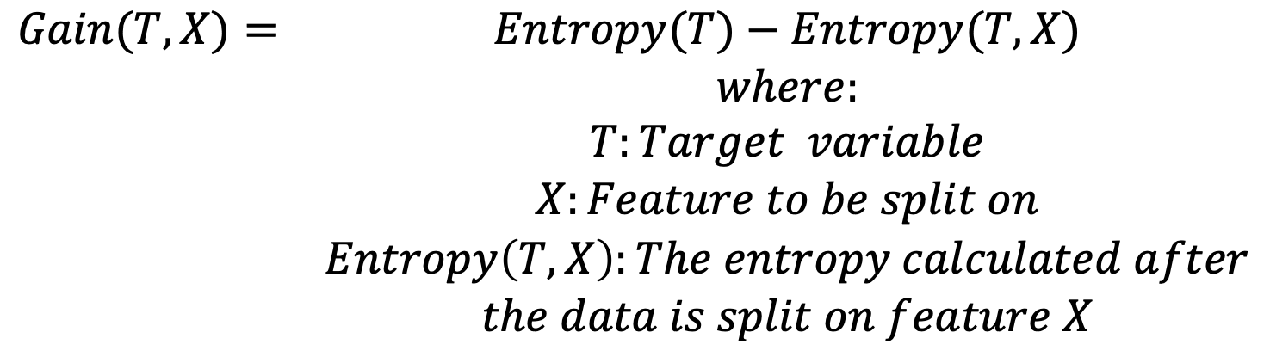
Common splitting algorithms: Information Gain
Used with splitting the data using entropy
Calculated as the entropy reduction after the dataset is branched on some attribute

Slide 36
Common splitting algorithms: Information Gain
So less impure node requires less information to describe it
A more impure node requires more information
Information theory is a measure to define this degree of disorganisation in a system known as Entropy

Slide 37
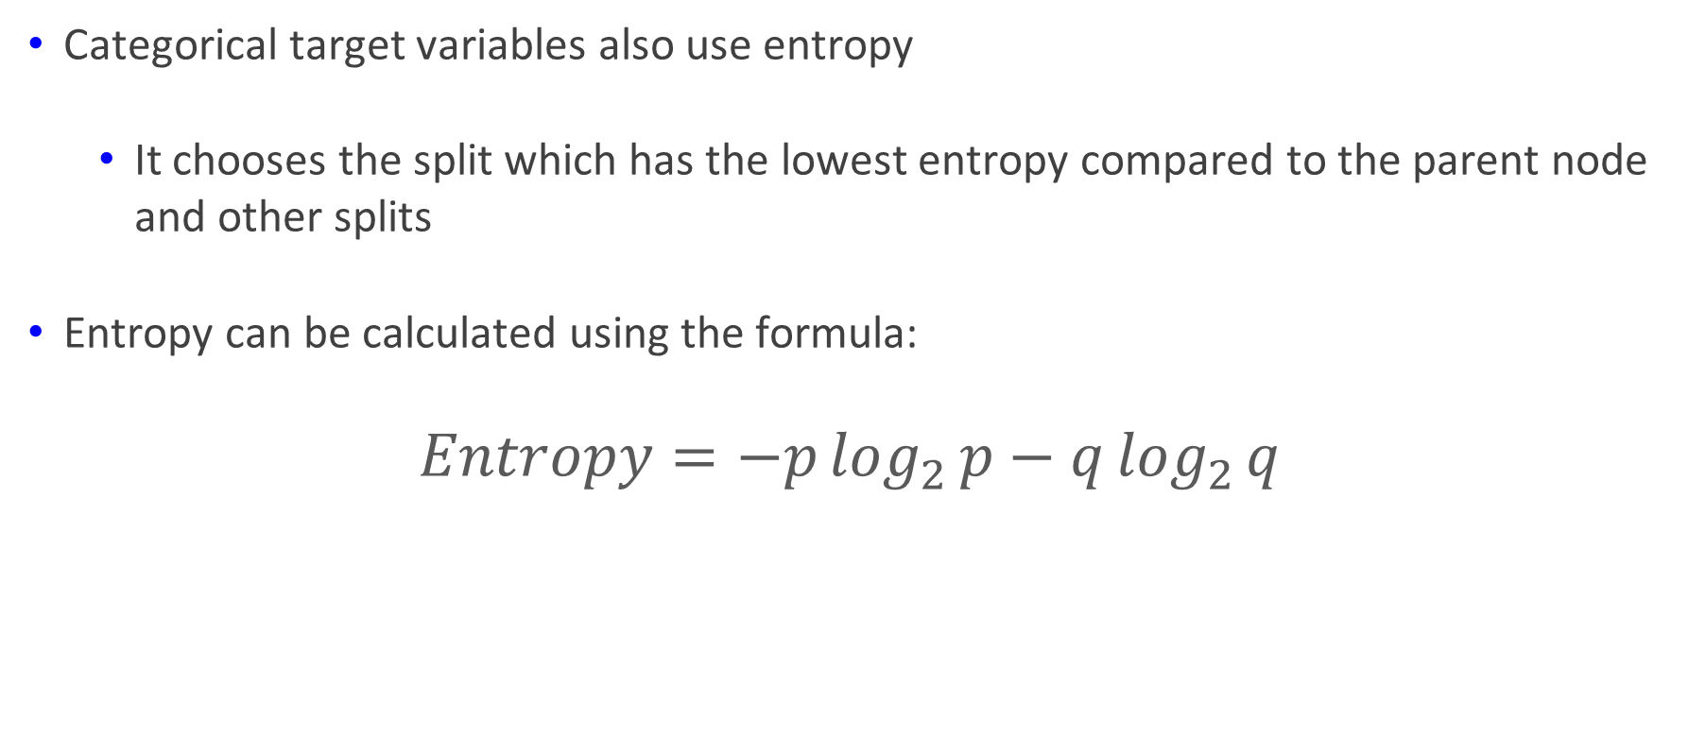
Common splitting algorithms: Information Gain
Categorical target variables also use entropy
  It chooses the split which has the lowest entropy compared to the parent node and other splits
Entropy can be calculated using the formula:
$$Entropy=−p\log_{2}{p}−q\log_{2}{q}$$

Slide 38
Common splitting algorithms: Information Gain
If the sample is entirely homogeneous, then the entropy is zero
If the sample is an equally divided (50% / 50%), it has an entropy of one
Where p and q are the probability of success and failure respectively in that node
The lesser the entropy, the better it is

Slide 39
Common splitting algorithms: Information Gain
Steps to calculate Entropy for a split
  Calculate entropy of the parent node
  Calculate entropy of each node of split and calculate the weighted average of all sub-nodes available in split

Slide 40
Common splitting algorithms: Information Gain
Parent node’s entropy = -(15/30) log₂ (15/30) -(15/30) log₂ (15/30) = 1
  The result of 1 shows an impure node
Gender’s entropy
    Female = -(2/10) log₂ (2/10) -(8/10) log₂ (8/10) = 0.72
    Male = -(13/20) log₂ (13/20) -(7/20) log₂ (7/30) = 0.93
Entropy for split Gender(Weighted entropy) =
(10/30) * 0.72 + (20/30) * 0.93 = 0.86

Slide 41
Common splitting algorithms: Information Gain
Entropy for Class
  A = -(6/14) log₂ (6/14) -(8/14) log₂ (8/14) = 0.99
  B = -(9/16) log₂ (9/16) -(7/16) log₂ (7/16) = 0.99
Entropy for split Class = (14/30) * 0.99 + (16/30) * 0.99 = 0.99
The tree splits on Gender as the Entropy for Split on Gender is the lowest among all

Slide 42
End of Presentation

